Slide 1
Cloud Computing Security Issues and Challenges
Dheeraj Singh Negi

Slide 2
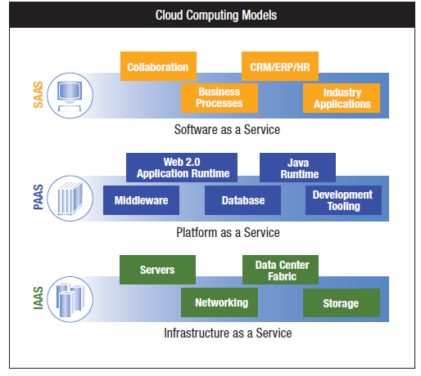

Slide 3
Above figure Cloud computing service delivery models Combining the three types of clouds with the delivery models we get a holistic cloud illustration as seen in Figure , surrounded by connectivity devices coupled with information security themes. Virtualized physical resources, virtualized infrastructure, as well as virtualized middleware platforms and business applications are being provided and consumed as services in the Cloud . Cloud vendors and clients’ need to maintain Cloud computing security at all interfaces. The next section of the paper introduces challenges faced in the Cloud computing domain.

Slide 4
CLOUD COMPUTING CHALLENGES
Security
Costing Model
Charging Model
Service Level Agreement (SLA)
Cloud Interoperability Issue

Slide 5
Costing Model
Cloud consumers must consider the tradeoffs amongst computation, communication, and integration. While migrating to the Cloud can significantly reduce the infrastructure cost, it does raise the cost of data communication, i.e. the cost of transferring an organization's data to and from the public and community Cloud and the cost per unit of computing resource used is likely to be higher. This problem is particularly prominent if the consumer uses the hybrid cloud deployment model where the organization's data is distributed amongst a number of public/private (in-house IT infrastructure)/community clouds. Intuitively, on- demand computing makes sense only for CPU intensive jobs

Slide 6
Charging Model
The elastic resource pool has made the cost analysis a lot more complicated than regular data centers, which often calculates their cost based on consumptions of static computing. Moreover, an instantiated virtual machine has become the unit of cost analysis rather than the underlying physical server. For SaaS cloud providers, the cost of developing multitenancy within their offering can be very substantial. These include: re-design and re- development of the software that was originally used for single-tenancy, cost of providing new features that allow for intensive customization, performance and security enhancement for concurrent user access, and dealing with complexities induced by the above changes. Consequently, SaaS providers need to weigh up the trade-off between the provision of multi- tenancy and the cost-savings yielded by multi-tenancy such as reduced overhead through amortization, reduced number of on-site software licenses, etc. Therefore, a strategic and viable charging model for SaaS provider is crucial for the profitability and sustainability of SaaS cloud providers

Slide 7
Service Level Agreement (SLA)
Although cloud consumers do not have control over the underlying computing resources, they do need to ensure the quality, availability, reliability, and performance of these resources when consumers have migrated their core business functions onto their entrusted cloud. In other words, it is vital for consumers to obtain guarantees from providers on service delivery. Typically, these are provided through Service Level Agreements (SLAs) negotiated between the providers and consumers. The very first issue is the definition of SLA specifications in such a way that has an appropriate level of granularity, namely the tradeoffs between expressiveness and complicatedness, so that they can cover most of the consumer expectations and is relatively simple to be weighted, verified, evaluated, and enforced by the resource allocation mechanism on the cloud. In addition, different cloud offerings (IaaS, PaaS, and SaaS) will need to define different SLA meta specifications. This also raises a number of implementation problems for the cloud providers. Furthermore, advanced SLA mechanisms need to constantly incorporate user feedback and customization features into the SLA evaluation framework

Slide 8
Cloud Interoperability Issue
Currently, each cloud offering has its own way on how cloud clients/applications/users interact with the cloud, leading to the "Hazy Cloud" phenomenon. This severely hinders the development of cloud ecosystems by forcing vendor locking, which prohibits the ability of users to choose from alternative vendors/offering simultaneously in order to optimize resources at different levels within an organization. More importantly, proprietary cloud APIs makes it very difficult to integrate cloud services with an organization's own existing legacy systems (e.g. an on-premise data centre for highly interactive modeling applications in a pharmaceutical company).The primary goal of interoperability is to realize the seamless fluid data across clouds and between cloud and local applications. There are a number of levels that interoperability is essential for cloud computing. First, to optimize the IT asset and computing resources, an organization often needs to keep in-house IT assets and capabilities associated with their core competencies while outsourcing marginal functions and activities (e.g. the human resource system) on to the cloud. Second, more often than not, for the purpose of optimization, an organization may need to outsource a number of marginal functions to cloud services offered by different vendors. Standardization appears to be a good solution to address the interoperability issue. However, as cloud computing just starts to take off, the interoperability problem has not appeared on the pressing agenda of major industry cloud vendors

Slide 9
Security
It is clear that the security issue has played the most important role in hindering Cloud computing acceptance. Without doubt, putting your data, running your software on someone else's hard disk using someone else's CPU appears daunting to many. Well-known security issues such as data loss, phishing, botnet (running remotely on a collection of machines) pose serious threats to organization's data and software. Moreover, the multi-tenancy model and the pooled computing resources in cloud computing has introduced new security challenges that require novel techniques to tackle with. For example, hackers can use Cloud to organize botnet as Cloud often provides more reliable infrastructure services at a relatively cheaper price for them to start an attack

Slide 10
Conclusion
Although Cloud computing can be seen as a new phenomenon which is set to revolutionise the way we use the Internet, there is much to be cautious about. There are many new technologies emerging at a rapid rate, each with technological advancements and with the potential of making human’s lives easier. However, one must be very careful to understand the security risks and challenges posed in utilizing these technologies. Cloud computing is no exception. In this PPT key security considerations and challenges which are currently faced in the Cloud computing are highlighted. Cloud computing has the potential to become a frontrunner in promoting a secure, virtual and economically viable IT solution in the future.

